Slide 1
Next Hikes PROJECT 1
By Oshika Tomar

Slide 2
Data Wrangling
( Also known as Data Cleaning), data remediation, or data munging, refers to a set of processed used to convert raw data into more uisable formats.
Examples :
Multiple date source are combined into single dataset for analysis.
Detecting Data Gaps
Identifying extreme outliers.

Slide 3
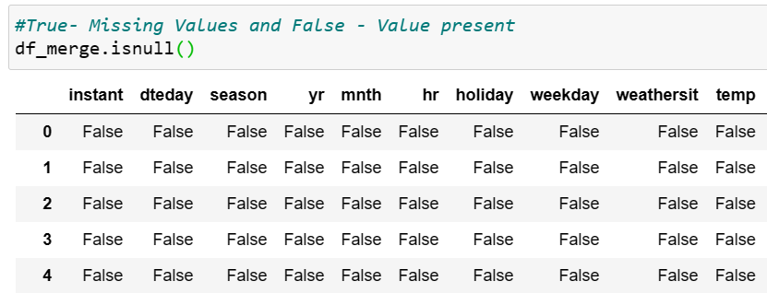
Steps involved in data wrangling
Discovery (identifying patterns or issues in data set e.g. missing or incomplete values)
Structuring ( Transforming raw data into structured data for analytical tool)
Cleaning ( Removing inherit errors in the data that can diminish the result)
E.g. Changing the name, sorting or rearranging, conversion of data, addressing missing or incorrect data, filtering data
4) Data Transformation (Restructuring the data to facilitate analysis.)

Slide 4

Steps involved in data wrangling
1) Enriching (Transform into useful data, determine do u have all the data ? or merge new data with existing to append columns and rows, Compiling and summarizing the data, re-sampelling)
2) Validating ( ensuring data is consistent and of sufficient quality, discover issues, conclude that data is ready to be analyzed)
3) Publishing ( Making it available to analysis for others)

Slide 5
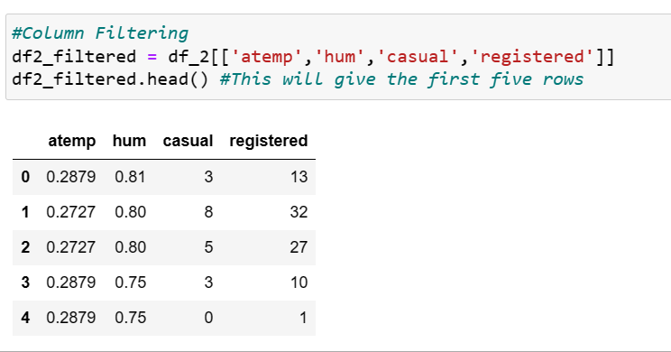
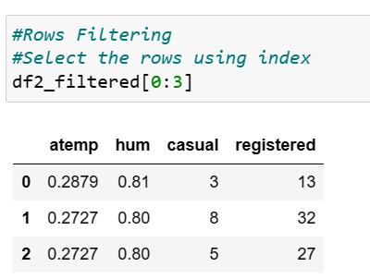
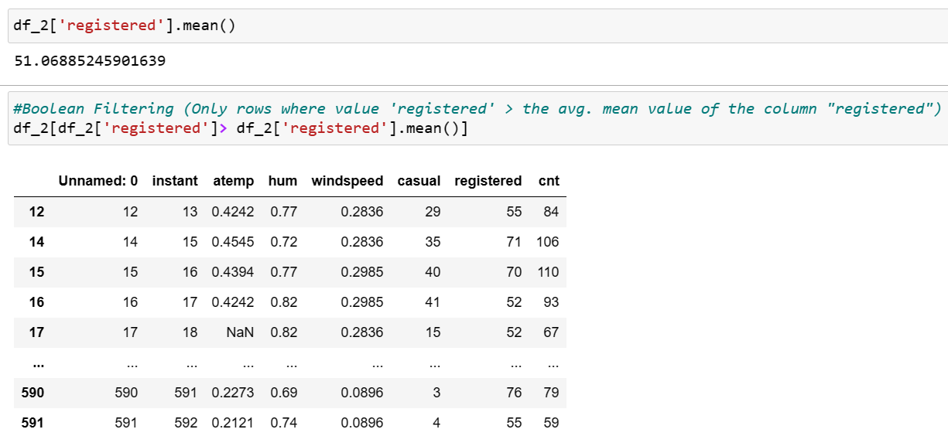
Data Wrangling includes
Column Filtering
Row Filtering
Boolean Filtering

Slide 6
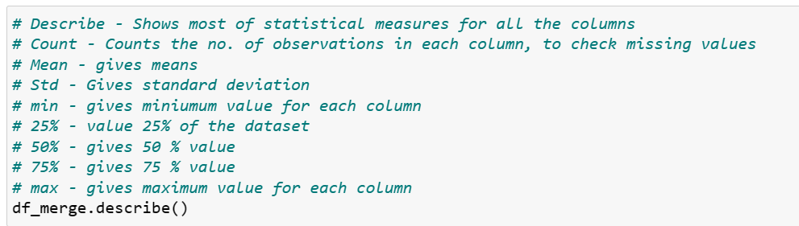
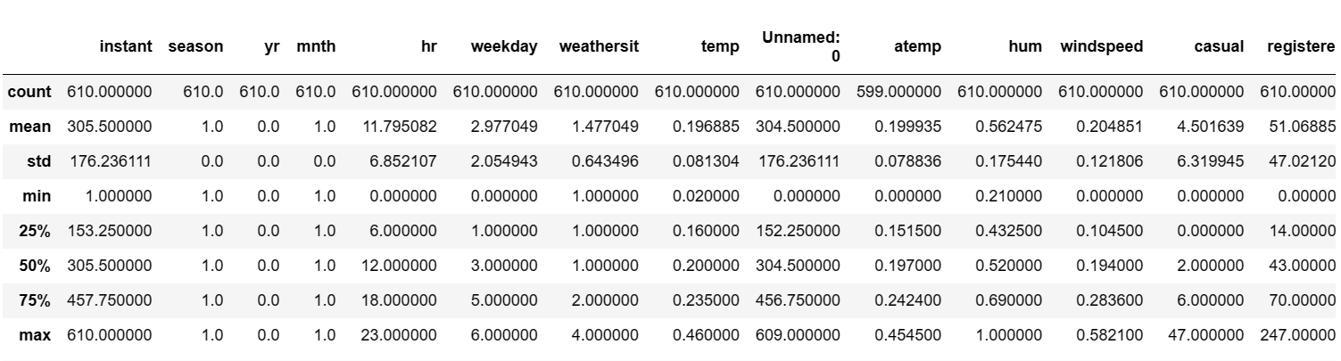
Describe() a DataSet

Slide 7
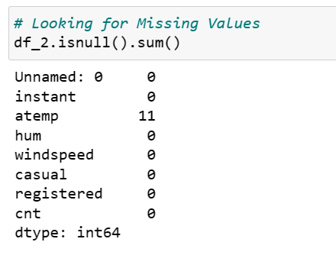
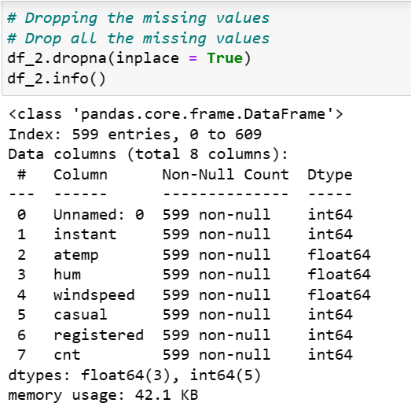
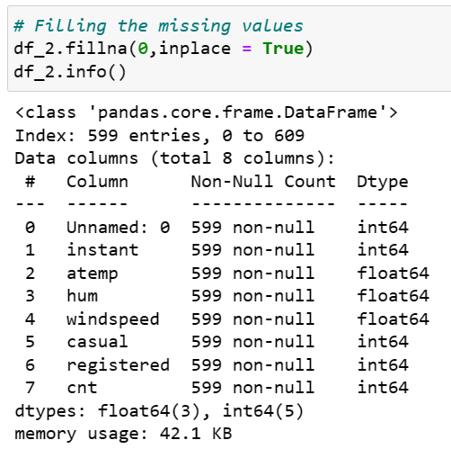
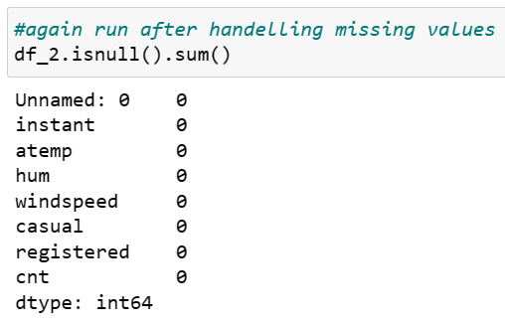
Handling Missing Values

Slide 8
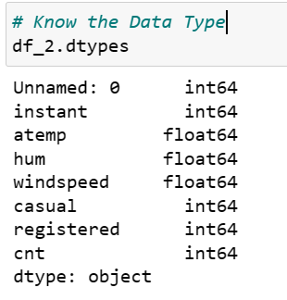
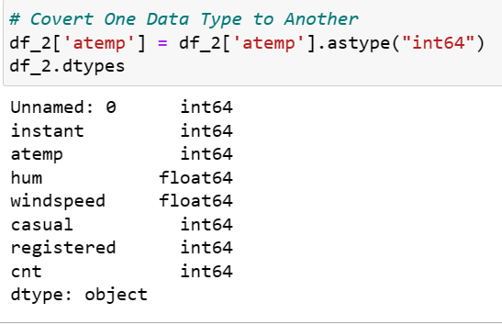
Datatype Conversion

Slide 9
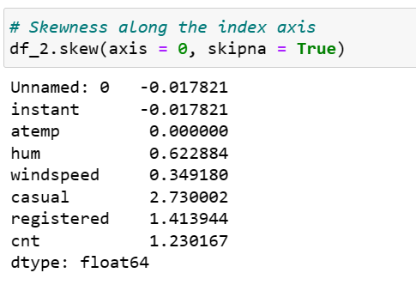
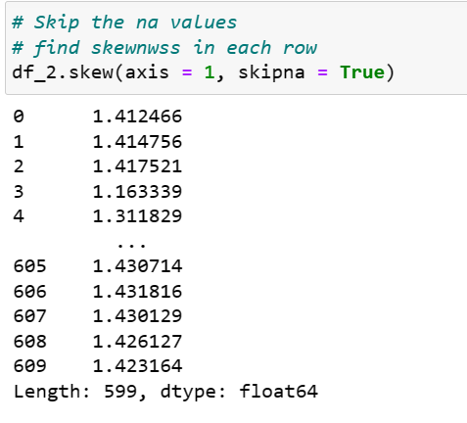
Skewness and correlation of the data

Slide 10
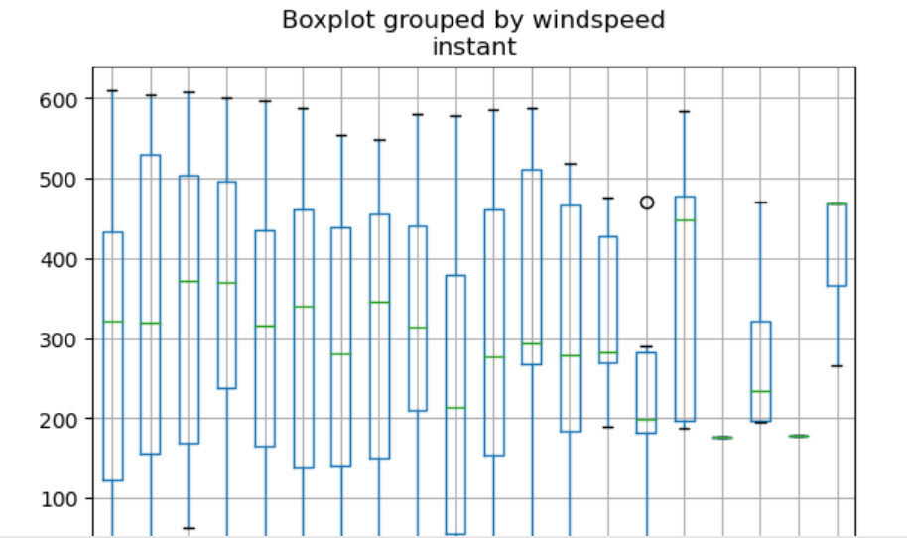
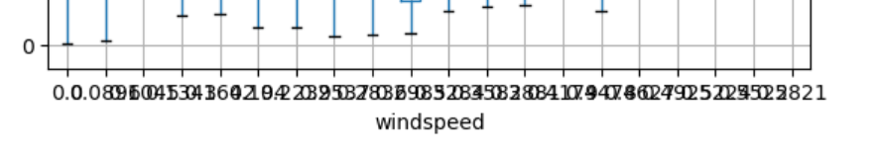

Slide 11
THANK YOU
Oshika Tomar
oshikatomar13@gmail.com

